Slide 1

Group ‘A’
Pratibha Bhalerao
Ashish Bachuwar
Srikanth Bura
Isaac Bendahan
Brunda Anantha
Final Data Product Presentation Unity Shop
1

Slide 2



Content
How Might We?
Current Barter System
How Unity Shop is Different
Value Proposition
Workflow
Data on People Bartering Today
Storyboard Summary
Validate & Test
Prototype Demo
Prototype Demo
Yeshiva University | Katz School

Slide 3
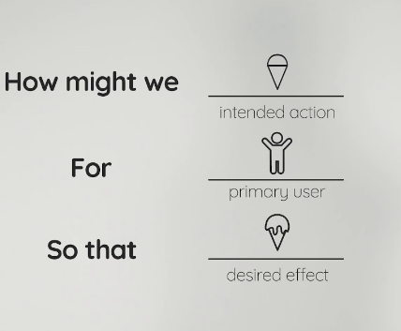
How Might We?
How might we create an ecommerce platform for bartering?
How might we develop a user-friendly interface that allows users to explore endless possibilities of bartering?
Yeshiva University | Katz School

Slide 4
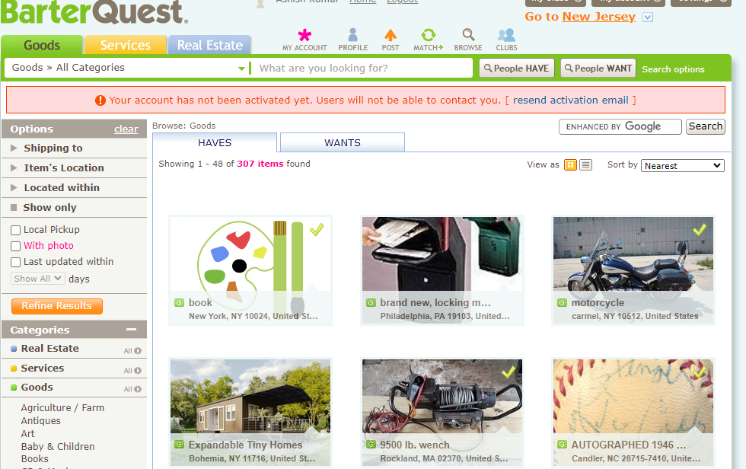
Current Bartering System
Platforms such as BarterQuest only have traditional bartering techniques/ways:
Exchange products
Exchange services
They don’t offer:
No flexibility for users
UI is not user-friendly
No events
Yeshiva University | Katz School
Notes:
Problem Statement: The lack of a well-designed homepage with interactive, easy-to-use features on the existing e-commerce platforms which do not provide a one-stop comprehensive solution for customers and sellers to customize their experience along with buy, sell, barter, design, resell, partner, and use AI features resulting in limitations, pain areas, and a lack of value. This is leading to low user engagement and a poor user experience.
Solution statement : Our solution is to create a homepage that provides a one-stop-shop for users, allowing them to customize their experience to meet their unique needs & work together i.e., by providing buying, selling, bartering, designing, reselling, partnering, and AI features, we aim to create a platform that provides value to both customers and sellers. Our solution is based on the community’s feedback, which identifies the pain points and limitations in existing e-commerce platforms, thus improving user engagement and provide a superior user experience

Slide 5
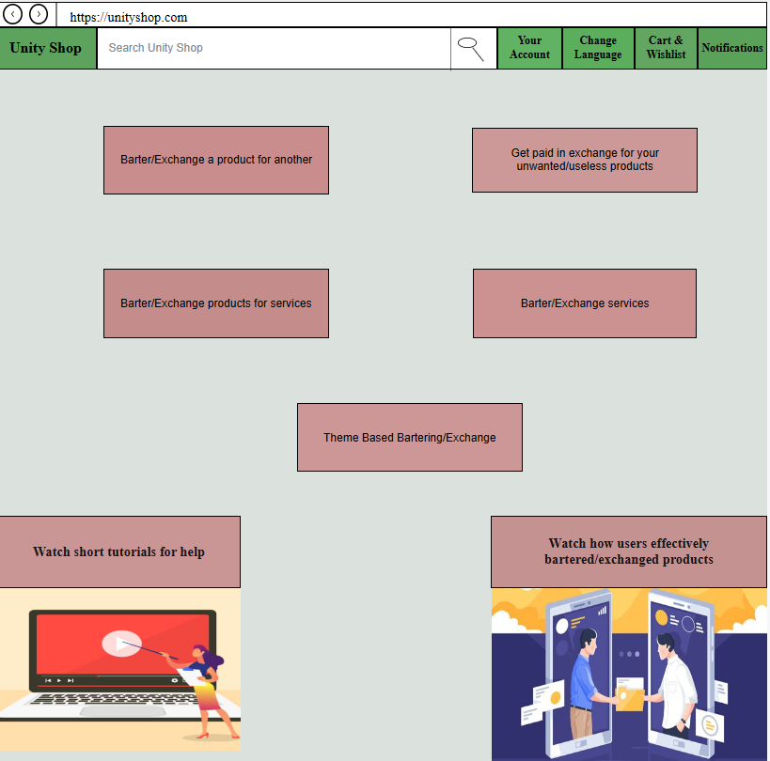
How Unity Shop is Different
Exchange products
Exchange products (High Value) for services & vice-versa
Get your unvalued/unwanted products evaluated ‘Your Way’ & get paid
Theme based bartering
Exchange services
Tutorials, Tips/Tricks for help
Yeshiva University | Katz School
Notes:
Problem Statement: The lack of a well-designed homepage with interactive, easy-to-use features on the existing e-commerce platforms which do not provide a one-stop comprehensive solution for customers and sellers to customize their experience along with buy, sell, barter, design, resell, partner, and use AI features resulting in limitations, pain areas, and a lack of value. This is leading to low user engagement and a poor user experience.
Solution statement : Our solution is to create a homepage that provides a one-stop-shop for users, allowing them to customize their experience to meet their unique needs & work together i.e., by providing buying, selling, bartering, designing, reselling, partnering, and AI features, we aim to create a platform that provides value to both customers and sellers. Our solution is based on the community’s feedback, which identifies the pain points and limitations in existing e-commerce platforms, thus improving user engagement and provide a superior user experience

Slide 6
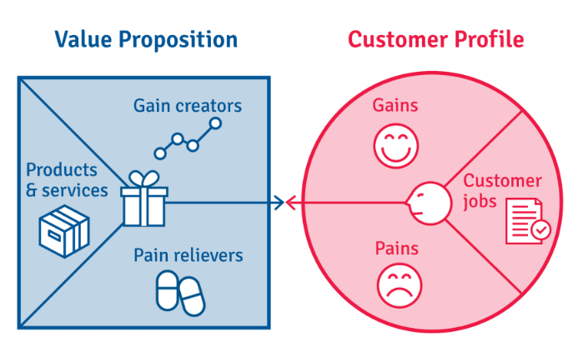
Value Proposition
Saves time & efforts - Events & Unity Shop’s help with shipping
Expanding trading possibilities
Knowing hidden value - Save & earn money
Avoiding waste
Enhance the user experience: 1) Engaging 2) Fun elements 3) Tutorials
Yeshiva University | Katz School
Notes:
- Value Prop :
The value proposition of this solution is to provide a comprehensive and customizable ecommerce platform that addresses the pain points and limitations of existing platforms. Our platform actually adds value not only by providing buy, sell, resell, partner features, but also the ability to design, barter, provide value to unvalued products & utilize AI features in their shopping journey. This provides convenience, saves time, and enhances the user experience.
Unity Shop as a whole leverages users data in various ways. From customers browsing history to purchase history, involvement of users in various features, how they’re working together etc., Based on this data, the platform then offers personalized recommendations, experiences, optimized features, improve inventory management etc.,

Slide 7








Workflow
Unity Shop Platform
Yeshiva University | Katz School

Slide 8
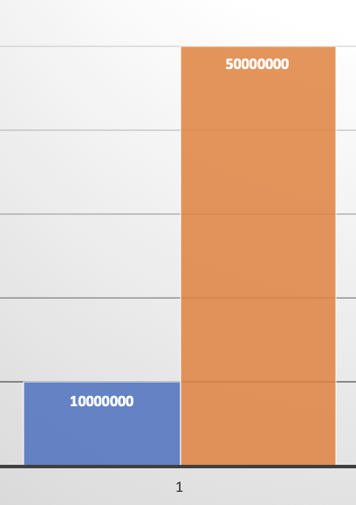
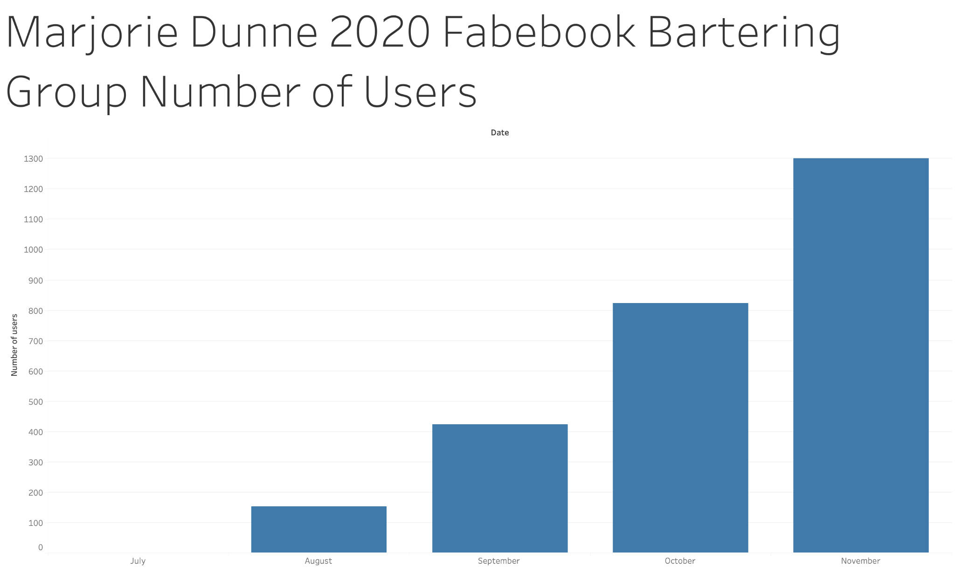
How many are bartering today?
10M barter monthly
50M haved barter at least once in their lifetime
1,100 Bartering Centers in the US
Yeshiva University | Katz School
Notes:
There are 1,100 bartering centers in the US
Marjorie Dunne in 2020 created a facebook group to get rid of unwanted items in exchange of favors and it turned out that in 5 months the group got 1,300 members.
We calculate that there are at least 10 million americans that barter on a monthly basis and about 50 million that have done it at least once in their life
All this without a central and effective platforms that can make bartering even more enjoyable and with less friction

Slide 9
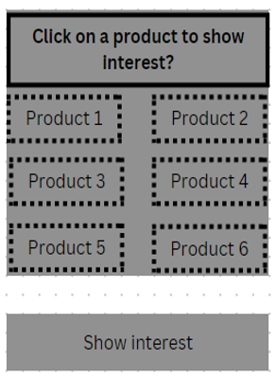
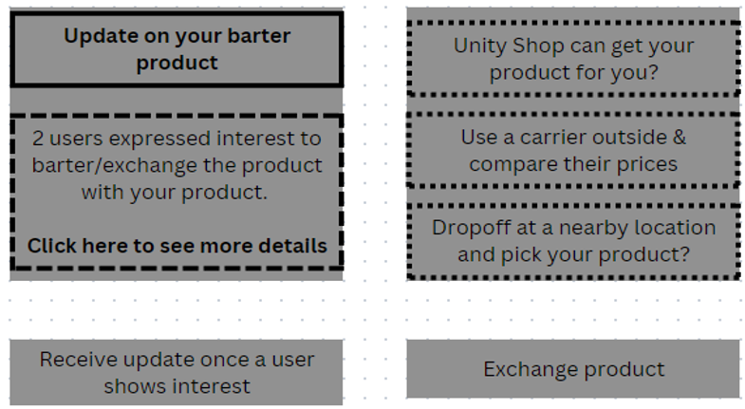
Storyboard Summary
Storyboard roadmap for bartering
Yeshiva University | Katz School

Slide 10

Validate & Test
Microcopy
Time & Click Test (Usability Test)
Navigation Test
Yeshiva University | Katz School
Notes:
- Value Prop :
The value proposition of this solution is to provide a comprehensive and customizable ecommerce platform that addresses the pain points and limitations of existing platforms. Our platform actually adds value not only by providing buy, sell, resell, partner features, but also the ability to design, barter, provide value to unvalued products & utilize AI features in their shopping journey. This provides convenience, saves time, and enhances the user experience.
Unity Shop as a whole leverages users data in various ways. From customers browsing history to purchase history, involvement of users in various features, how they’re working together etc., Based on this data, the platform then offers personalized recommendations, experiences, optimized features, improve inventory management etc.,

Slide 11
How does bartering look today?
https://cloud.justinmind.com/usernote/prototype/a4dd625735691c2eb8c8d8ceb84895b9efe7247296eeaf5e929aadebee471480
Prototype Demo
Yeshiva University | Katz School

Slide 12
Any Questions?
Yeshiva University | Katz School

Slide 13
Thank you
Yeshiva University | Katz School

